Slide 1


T

Slide 2
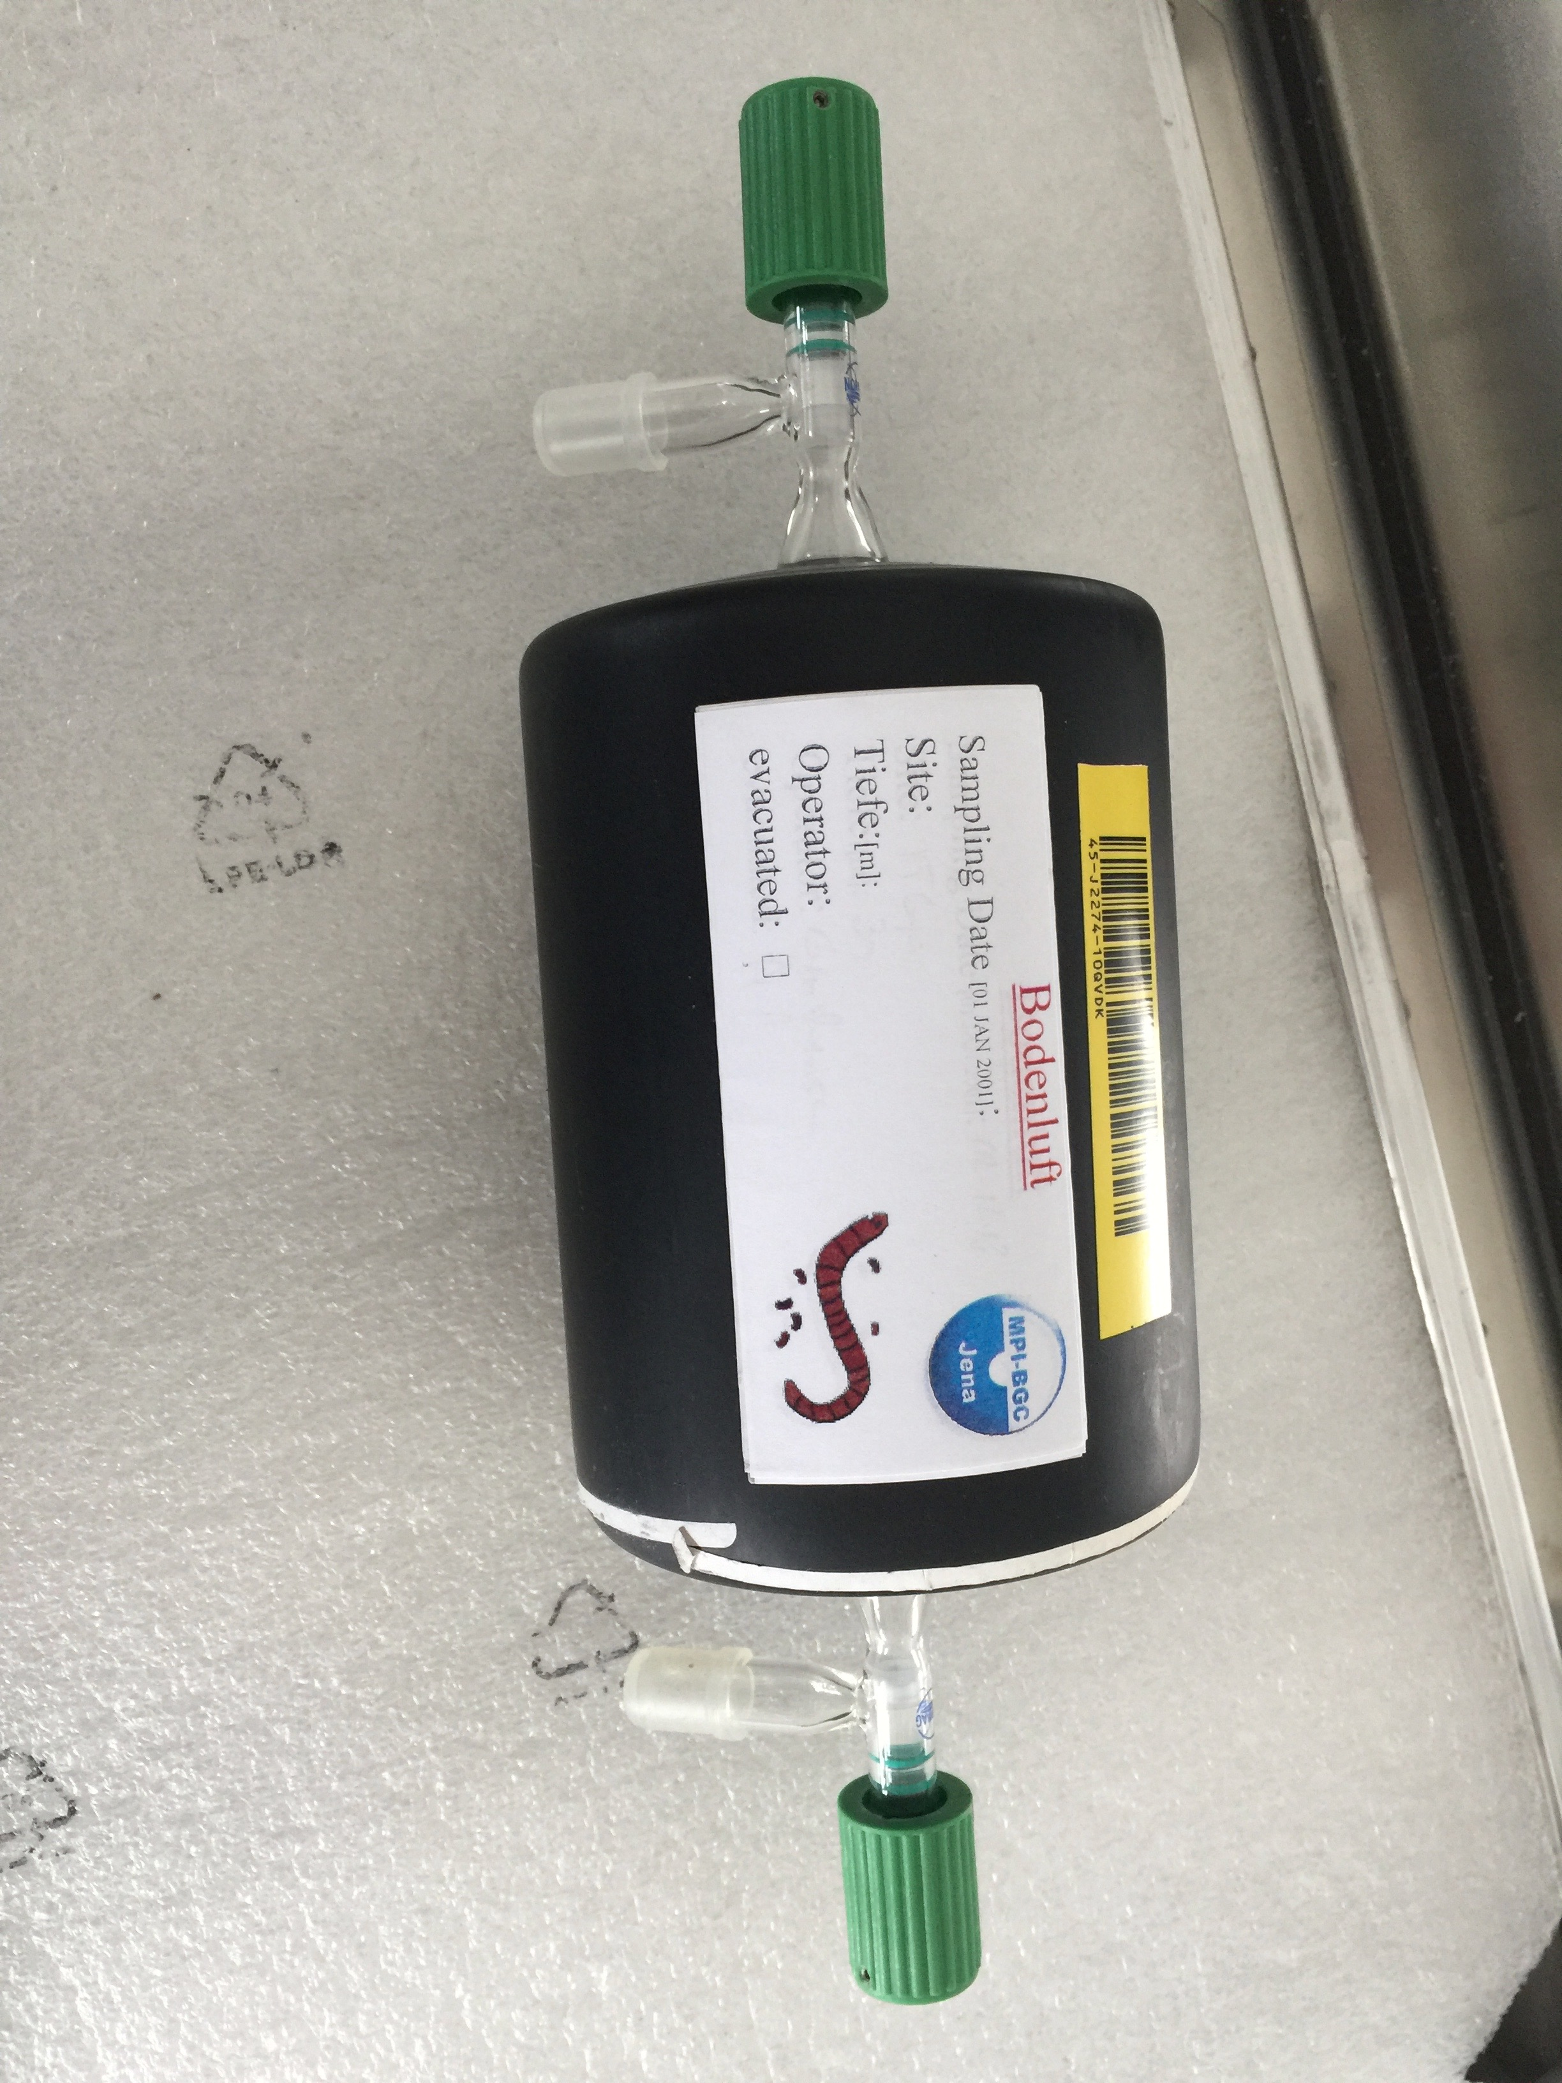
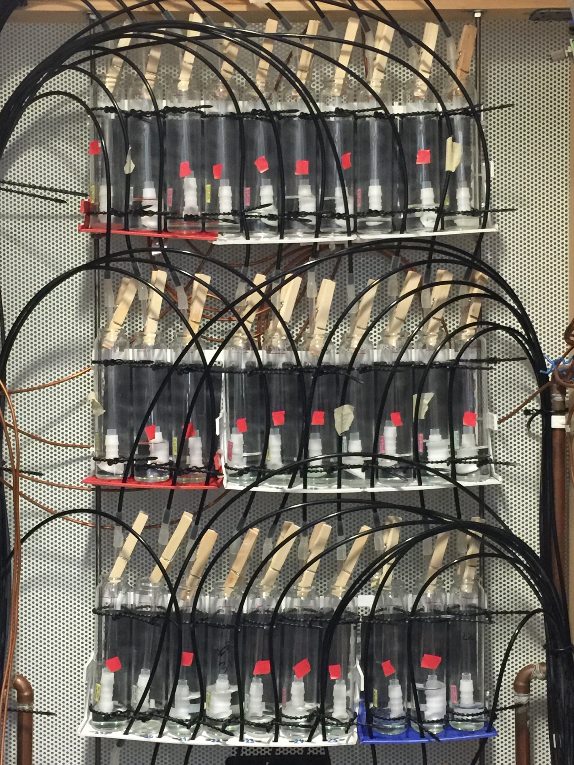
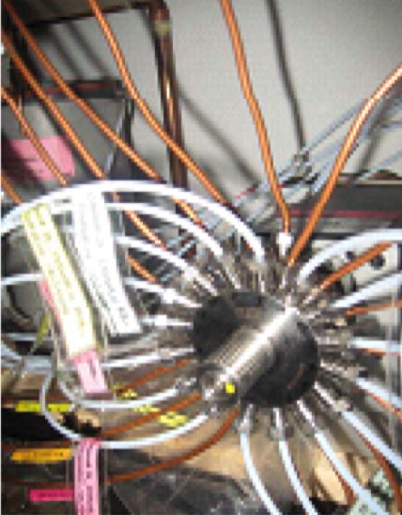
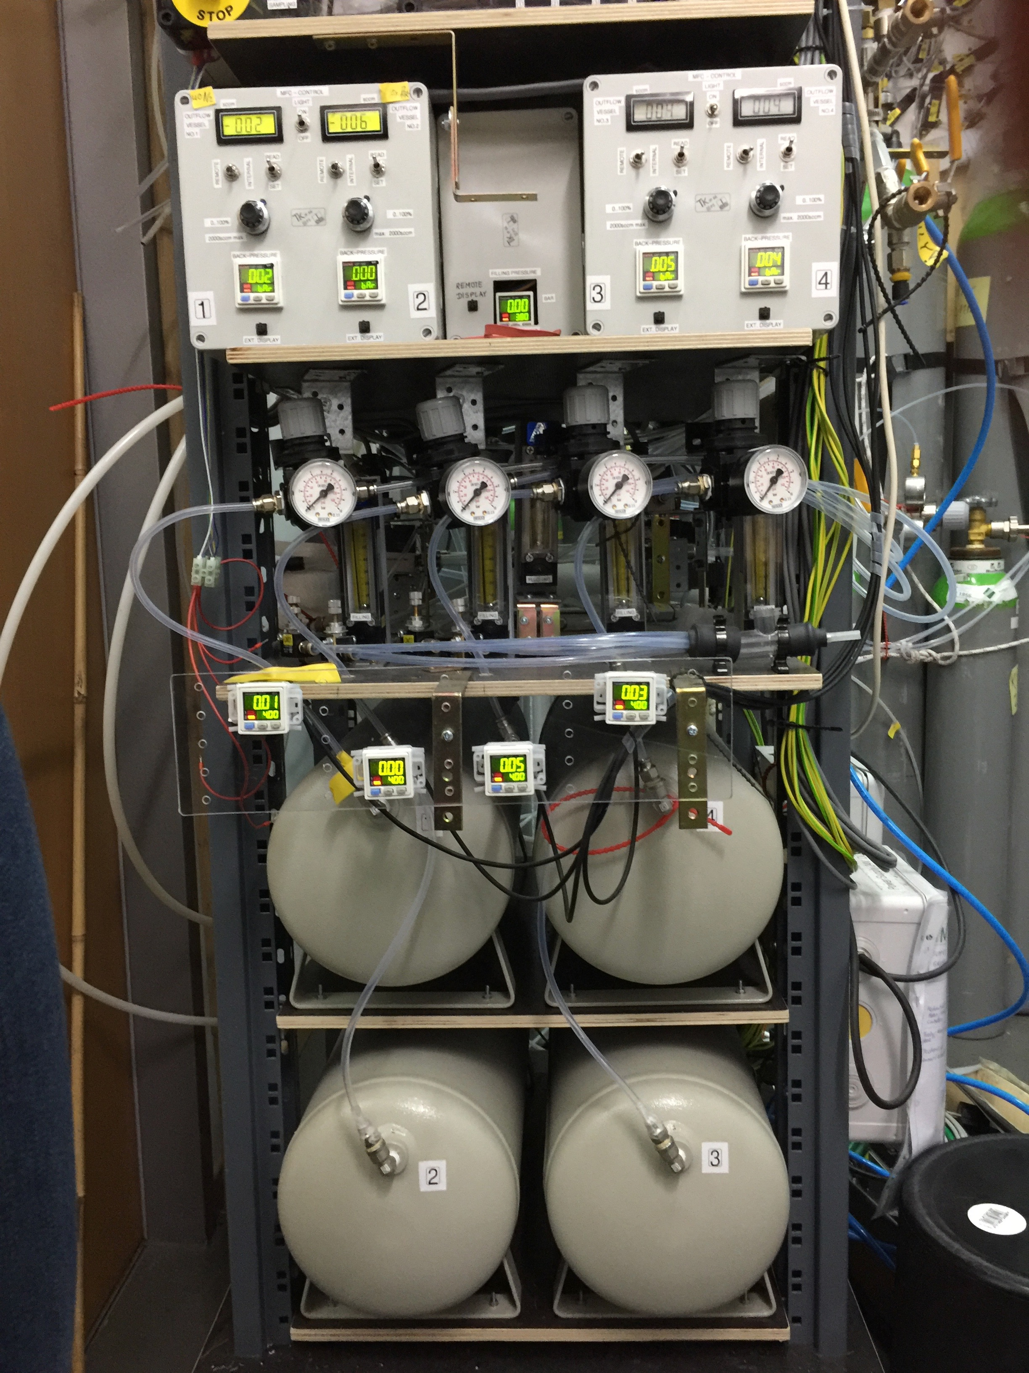
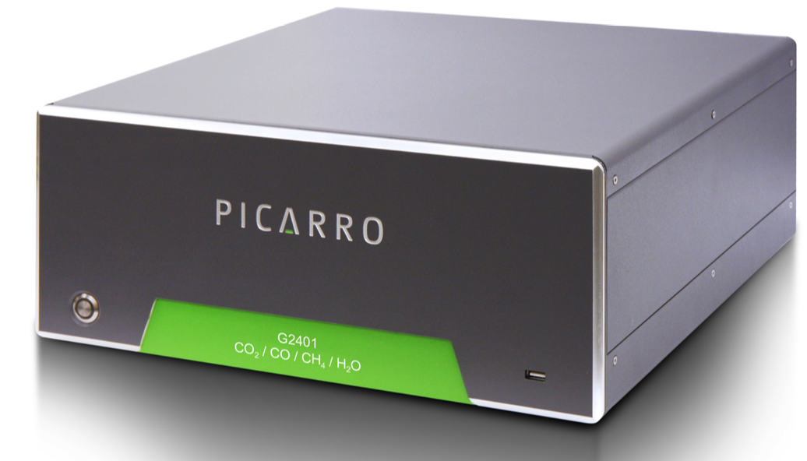
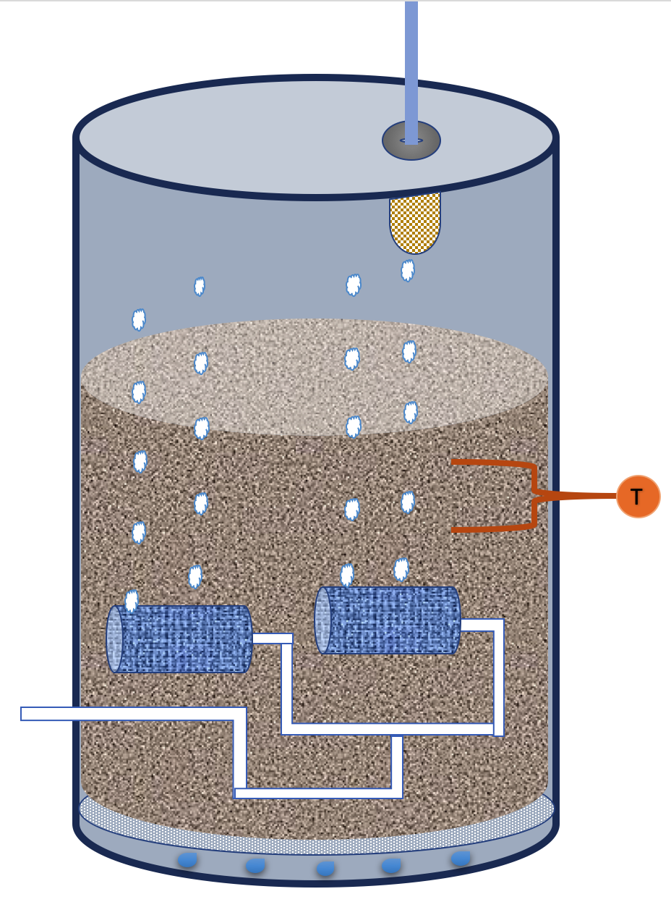

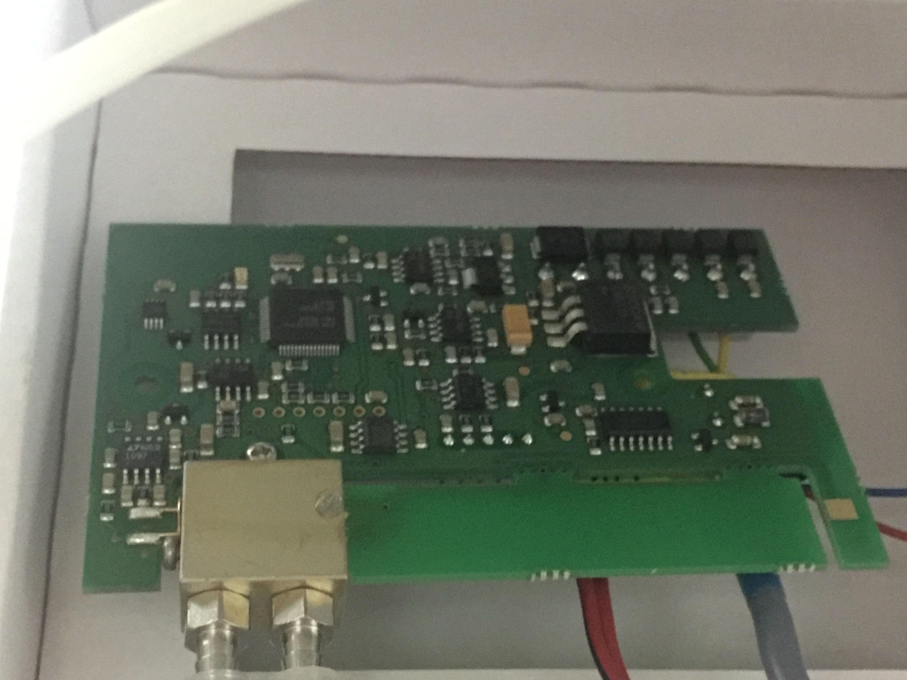
Gas flask
Automated column selector (Valco valve)
Air bubbler
Gas flow
controller
CO₂, CH₄, H₂O
CO₂-free gas
Data logger
Soil column

Slide 3
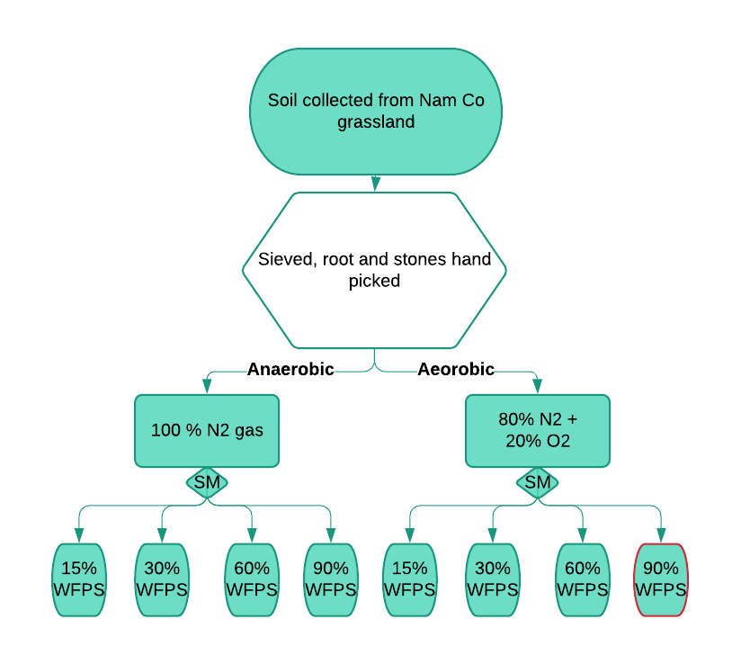
–5˚C
Freezing
Thawing
+10˚C

Slide 4
C1
k₁
CO₂
C2
CO₂
k₂

